Slide 1
Resources for the Transition out of Foster Care
Katherine Calimlim Medical Anthropology and Global Health
Steven Robinson UW School of Social Work
Daina Reimanis UW School of Nursing
Kiarra Levesque and Tinny Liang UW School of Medicine

Slide 2
Motivational Statement
Statistics
Notes:
https://youthcare.org/why-are-youth-homeless/

Slide 3




Current Programs
Government Programs:
Fostering Connections to Success and Increasing Adoptions Act of 2008
Extended Foster Care Program
Notes:
Kiarra
To be eligible for the Extended Foster Care program, youth must meet the following criteria on their 18th birthday:
Dependent; and
Enrolled in high school or a high school equivalency program;
Enrolled, applied for, or can show intent to timely enroll in a post-secondary academic or post-secondary vocational certification program;
Participating in a program or activity designed to promote or remove barriers to employment, including part-time employment;
Employed 80 hours or more a month; or
Unable to engage in any of the above activities due to a documented medical condition
Supplemental Education Transition Planning (SETuP) Program
http://features.crosscut.com/aging-out-of-foster-care
Mockingbird Society - advocacy program for those in foster care, advocate for longer times in foster care. Target both education of foster children and foster system reform
Treehouse - Provide support and services for independent living, transitional living, extension of foster care and general services for young adults
YV life set - helping foster children become independent adults
SETuP - case workers, schools work to help foster child develop the education plan to transition out
Great Resources available - not centralized
Government 21 program is an opt in program
Depends on case worker and support system

Slide 4
Proposed solution
Centralized Location of Information via user friendly App
Target the community:
Children, Foster Parents, Case Workers, School Counselors, Teachers
Desired Outcome: Less foster children end up homeless and on the streets due to early intervention and access to resources to prepare for the transition while still in final years of high school
Test Effectiveness: Pilot Study
Notes:
Kiarra
Goal is to provide more organized, centralized resources for individuals in foster care
Target more than just the case worker - target the community of individuals that may interact with the child

Slide 5

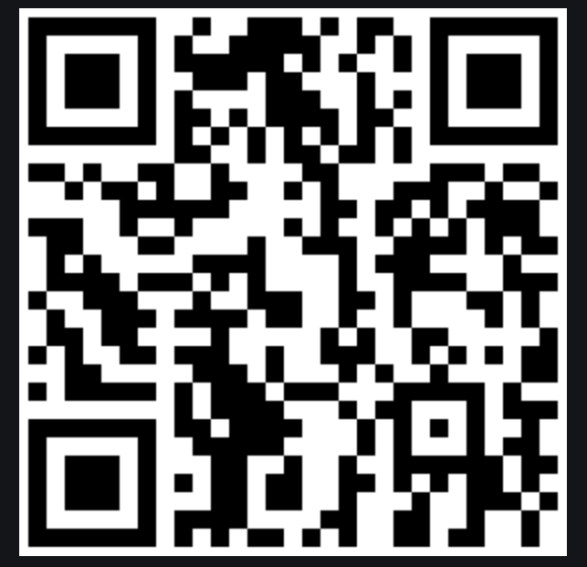








App Home Screen Layout
Housing,Shelters, and Day Centers
Employment
Social Support
Clothing
Higher Education
Food Resources
Community Resources
Healthcare
Notes:
QR code will be posted in classrooms, counselors’ offices, social work centers where it will be accessible to foster kids
the next slides will go more into depth in regards to each of the 8 sections

Slide 6
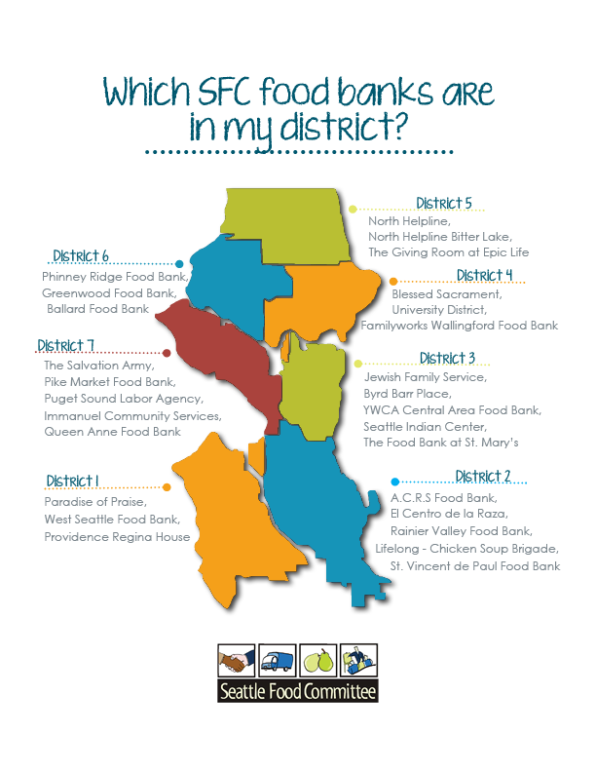
Food
Include criteria and eligibility info, hours,
phone numbers and bus routes
Categories:
Food bank navigator
Hot meal navigator (general)
“Food & Community” Youth/YA
“Food & Community”
The Doorway Project
Teenfeed
Street Youth Ministries (emergency)
Day Centers + Food:
Youthcare UDYC, Orion Center,
Jackson street, and more
Notes:
Stevie
General food bank map, eligibility information (proof of address, or not, what to do if homeless -- where to go, asking a shelter for a letter to say that you are homeless and staying in the area)

Slide 7
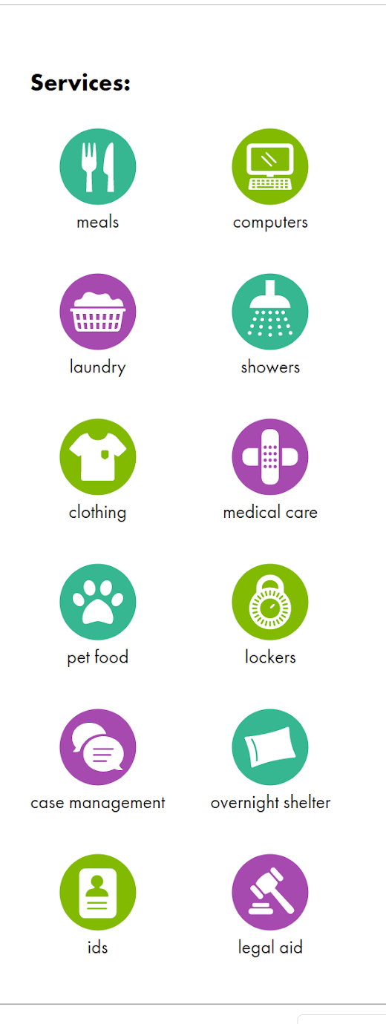
Emergency Housing & Shelters
Shelter Hotlines Ages 7-17: (206) 236-5437 Ages 18-24: (425)- 449-3868 List of Shelters / Locate Safe Parking
Safe Place Call / About National Runaway Hotline Call / Chat / Website
Day Centers OPEN NOW List of day centers
Transitional Housing About
Coordinated Entry for All About Complete your intake
Affordable Housing Search
Sections
Shelter Hotlines & Shelter locator
Day Centers
Transitional housing info
CEA
Affordable Housing Search
Easily compare what service sites offer with icons
Image from YouthCare.org
Notes:
Stevie
Some important phone numbers:
Youthcare: Hope Center 206-364-4355 Adolescent Shelter 206-694-4506
Safe place (1-800-422-8336), serves ages 12-17 staff about the city who will meet with a youth within 45 minutes to support with family reunification or emergency shelter
Shelters: Youthcare Orion Center & Jackson street, peace for the streets by kids from the streets (allows pets , 18+)
Friends of youth The Landing outreach line (425) 298-4846 --- can come to you.
Address: 16225 NE 87th Street, Suite A-1, Redmond WA 98052 (map it)
Bus Routes: Route 542; Route 545; King Co. Metro to Redmond Transit Center (8178 161st Avenue NE, Redmond, WA.)
Ages Served: Homeless Young Adults ages 18-24
Safe Parking
Lake Washington United Methodist Church
Overlake Christian Church
St. Jude catholic church
Day Centers: Lambert House LGBT Youth Community center, new horizons ministries (cedar street young adult shelter), new horizons youth drop in (has food,clothing,laundry, showers, mail phone), YMCA street youth drop in center (13-25 years) , YMCA young adult services (17-25)
Transitional Friends of Youth, New Ground housing program
CEA: Can complete CEA when you turn 17.5, and can complete CEA (coordinated entry assessment at youth care until 24. Friends of Youth's Drop-In Center located at 16225 NE 87th Street, Suite A-1 in Redmond. Assessments are completed Tuesdays from 10 am-12 pm. ).

Slide 8
Clothing
List of Locations for Foster Care Clothing
-The Treehouse Wearhouse
-YouthCare

Slide 9
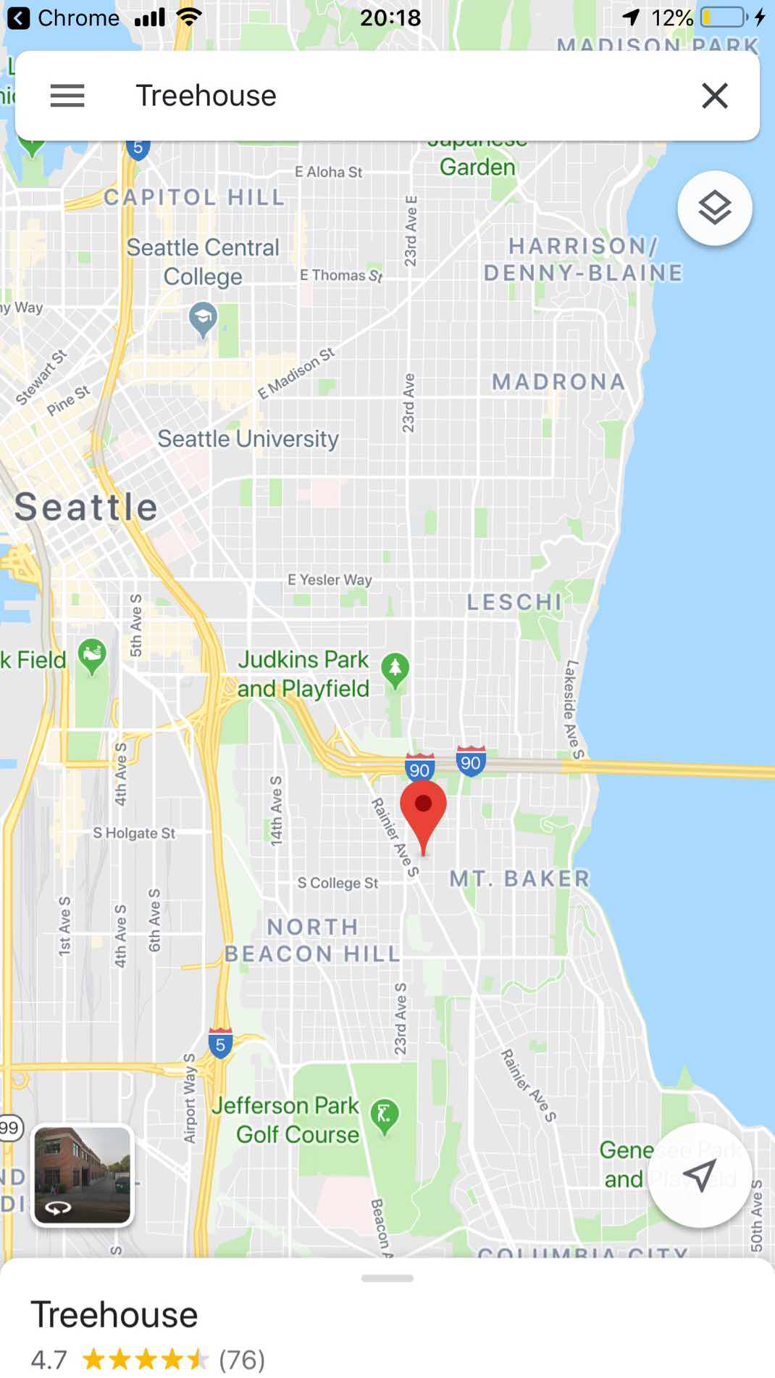
Clothing
Map
Seattle, WA “The Treehouse Wearhouse”
https://www.treehouseforkids.org/our-services/the-wearhouse/
“The Treehouse Wearhouse is a free store where youth in foster care and their caregivers can shop for high quality new and like-new clothing, shoes, school supplies, toys, books, free tickets to events and other essentials
(non-profit organization)

Slide 10


Health
Primary Care
Focus on Comprehensive Health
Emphasis on Mental Health Resources
Links to HealthCare Providers
Communication with child’s support system
Dental Care
Vision
Mental/Behavioral Health
Sexual/Reproductive Health
Nutrition/Excercise
Health Care Insurance
Notes:
Kiarra

Slide 11

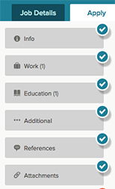



Employment
Notes:
Daina Reimanis
Include resume tools with previous work experience, directory of their own references, listings of local jobs that are hiring and their details
YearUp/YouthCare are very similar
Year Up: Different campuses in the puget sound area that partners with local companies to provide intensive training
YouthCare: sector-based training, offer internships
100k oppurtunities initiative: goal is to connect and employ youth corporate partners in king county with alaska airlines, microsoft, mod, nordstrom, starbucks, t-mobile
Treehouse: not only career services, but educational as well: helps connect youth, foster youth focused, based in seattle (also mentioned in clothing - they provide a variety of resources)

Slide 12
Higher Education - What are the options?
Tips for starting the conversation with your parent about next steps
Kid to Parent Conversation Tips
Scholarship Information for kids, parents, and counselors
List of local programs and questionnaire to help navigate and option to loop in results to school counselor
What type of programs are out there?
Tap the college of interest to open conversation bubble - no real names used unless opt in
Tap another button to see list of free workshops
Connect with college students who were former foster kids
Notes:
Scholarship Information
National foster parent association
Casey Family Programs
Darko Rapotez Memorial College Scholarship fund for Aged out Foster Youth
Foster Care to Success
https://www.collegesuccessfoundation.org/home

Slide 13
Need Help? Resources in the Community
Crisis Line (206) 461- 3222
Safe Place (1-800-422-8336)
National Runaway Hotline (1-800-786-2929)
Shelter Hotlines:
Ages 7 - 17 (206) 236 - 5437
Ages 18-24 Shelter Hotline (425) 449 - 3868
How to’s
Other resources
LGBT
Sex Trafficking/ Genesis Project
Native American / Indigenous
Refugees/Undocumented
Directory of all Youth/Foster Programs
211
Crisis Line
Safe Place
Shelter Hotlines
National Runaway Hotline
Teenlink
How To’s
Get a phone
Receive mail/voicemails
Replace ID
Bus tickets/ Transportation
Other Resources
LGBT
Sex Trafficking / DV
Pet Care
Refugees/Undocumented
Notes:
Stevie
include if there is chat functionality: national runaway hotline, teenlink
How To’s
Get a phone: lifeline program
Receive mail with no address
Voicemail/message line options
DSHS/Social Security
Replace ID
Bus tickets : lazarus center, solid ground free transportation, tree house drivers education
LGBT : lambert house, the trevor project (866-488-7386), ingersollgendercenter (206-849-7859)
sex trafficking: genesis project (206.592.2362) National Domestic Violence Hotline – (800) 799−7233
native americans; unitedindians.org,
pets: one health clinic, seattle humane pet project hiv/aids + cancer, seattle humane pet loss support, seattle humane pet food bank
refugees/ Youthcare-Casa de los Amigos (Casa) - bilingual education, family reunification, Refugees Northwest through Lutheran Community Services Northwest (refugeechildren.net)

Slide 14
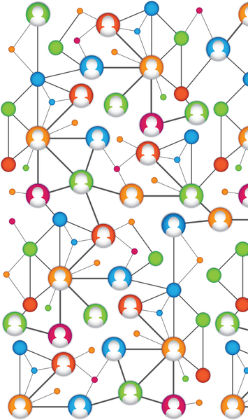
Social Support
Connect student with:
Teachers
Social Workers
Emergency Contacts
Foster Parents
Healthcare Providers
Local Shelters
School Counselors
Notes:
Daina Reimanis
This feature on the app would allow the youth to link/add people
who do you want to connect with, include communication info such as emails, telephone numbers
If the foster child decides to add their social worker, for example, the social worker would be notified.
For professionals who are linked, the layout would be different - they have all of their cases
With this feature we would want to be incredibly careful with privacy

Slide 15
Pilot Study Details
Target site - one local school district and its affiliated high schools
Recruitment process - distribute flyers with QRS code and website through school counselors between 10th and 11th grade to all foster students AND students who might benefit
Number of participants will be tracked via app/website activity
Non-binding
Periodic survey in app/on website to get feedback from students, parents, and counselors
Outcomes
comparison of rate of homeless foster children from the district prior and after the pilot study
Feedback from counselors, students, and parents
Utilization rates of the resources and app usage
Notes:
Tinny

Slide 16
Summary Slide
Motivations:
Goal:
Notes:
Daina Reimanis

Slide 17
References
https://www.yearup.org/about-us/our-locations/puget-sound/
https://100kopportunities.org/about-us/
https://www.mockingbirdsociety.org/
https://www.treehouseforkids.org/our-services/academic-resource-center/independent-transitional-living-support/
https://www.youthvillages.org/yvlifeset/
https://www.dcyf.wa.gov/services/extended-foster-care
http://www.hmcfostercarewa.org/

Slide 18
Thank you!
Questions??

